Slide 1
Channel Finder
Kay Kasemir
Aug. 2022

Slide 2
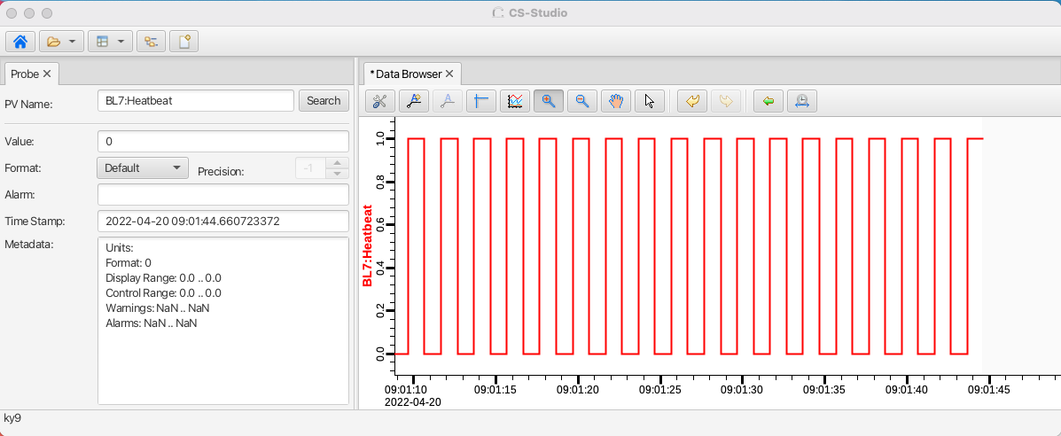
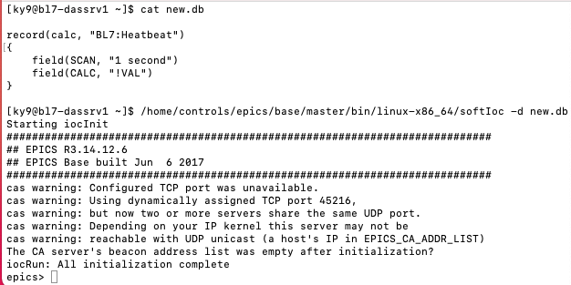
EPICS: Distributed & loosely coupled
Start IOC → PVs are online
No need to register IOC
No need to reserve PV names
Like internet
Flexibility!
Few central bottlenecks
Start IOC → PVs are online
No spell checker
No “list all IOCs”, “list all PVs”
Like internet
Chaos!
Likely need some level of control…

Slide 3
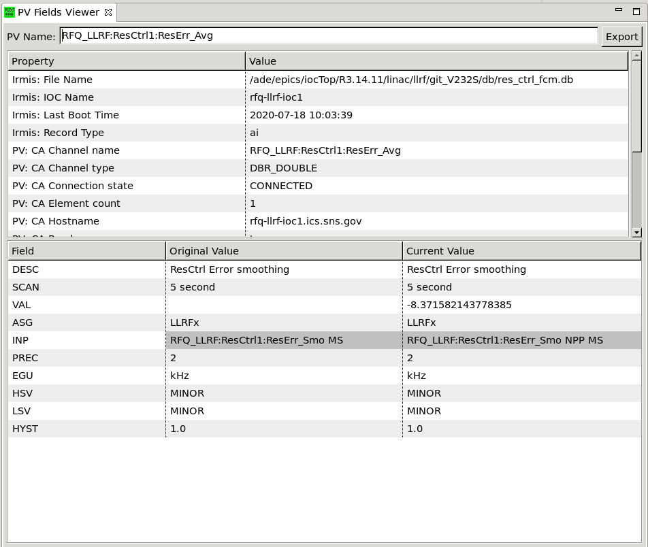
History: APS ‘IRMIS’, ‘crawler’
Resulting info
Which IOC last held that record?
When did it last boot? Where?
Initial value of fields?
Current value of fields?
SNS: Abandoned
Parsing st.cmd, *.db, following ‘cd’ commands and macros is hard!
IRMIS=Integrated Relational Model of Installed Systems

Slide 4
Channel Finder 101
Searchable list of “Channels”
Optional “Tags”
‘Magnet’
‘ImportantSetting’
Optional “Properties”
iocNAME = ‘NameOfIOC’
Type=‘Magnet’
Section=‘Front End’
Archive=‘Monitor, 00:01:00’
Zpos = ‘10m’ (position from start of accelerator)
Readback=‘NameOfAssociatedReadbackPV’
Find iocName for a PV
List all ‘Magnet’ channels
List all PVs with iocName=‘someIOC’
Get ‘archive’ settings for PVs
Locate Readback for some setpoint
?!
?!

Slide 5
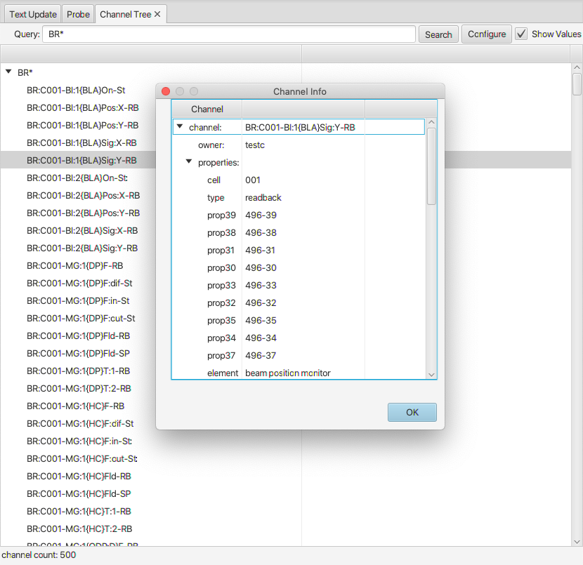
Ecosystem
Operator Interface/GUU Name Lookup, Channel Table CS-Studio
High-Level Apps Python
RecSync All record names, IOC Name, ‘info’ tags
IOCs
…
cf.find(‘DTL* type=Magnet’)
Channel Finder Web Service
Create Archive Config
REST API, Shell, Python
IRMIS Import
ElasticSearch (used to be MySQL, ca. 2009)
Maintenance, Statistics
REST API, Shell, Python

Slide 6
Initial Setup
Install & run Elasticsearch
→ Open web browser to http://localhost:9200
Install & run ChannelFinder
Open web browser to http://localhost:8080
Install & run Recceiver
Instrument IOCs to publish their records
In training setup, see /ics/examples/26_ChannelFinder

Slide 7
Instrumenting an IOC
abcApp/src/Makefile
ABC_DBD += reccaster.dbd
ABC_LIBS += reccaster
iocBoot/iocAbc/st.cmd
# Nice, but optional
epicsEnvSet("IOCNAME", "abc-ioc1")
epicsEnvSet("ENGINEER", "Fred")
epicsEnvSet("LOCATION", "Rack 123")

Slide 8
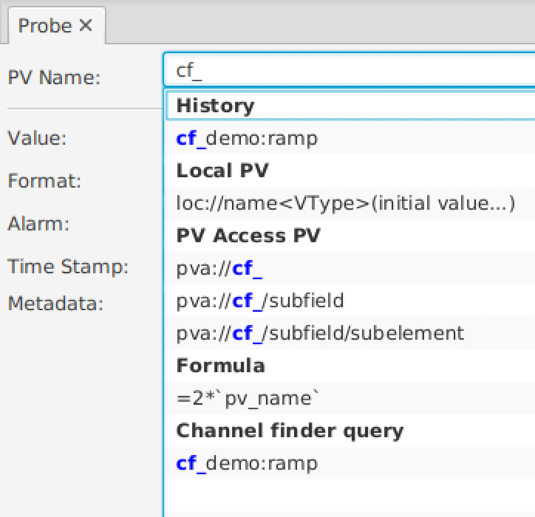
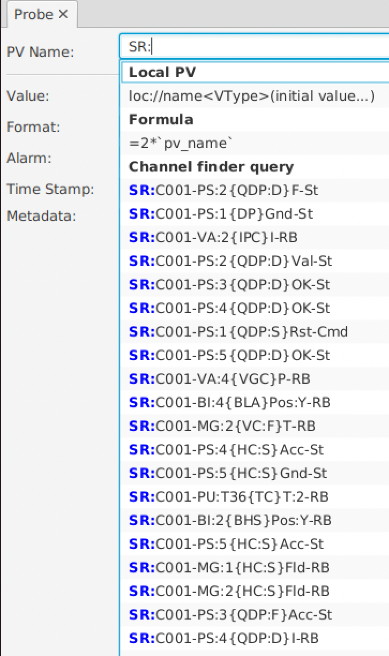
CS-Studio: PV Name Completion
Channel Finder demo channels
PVs from example IOC

Slide 9
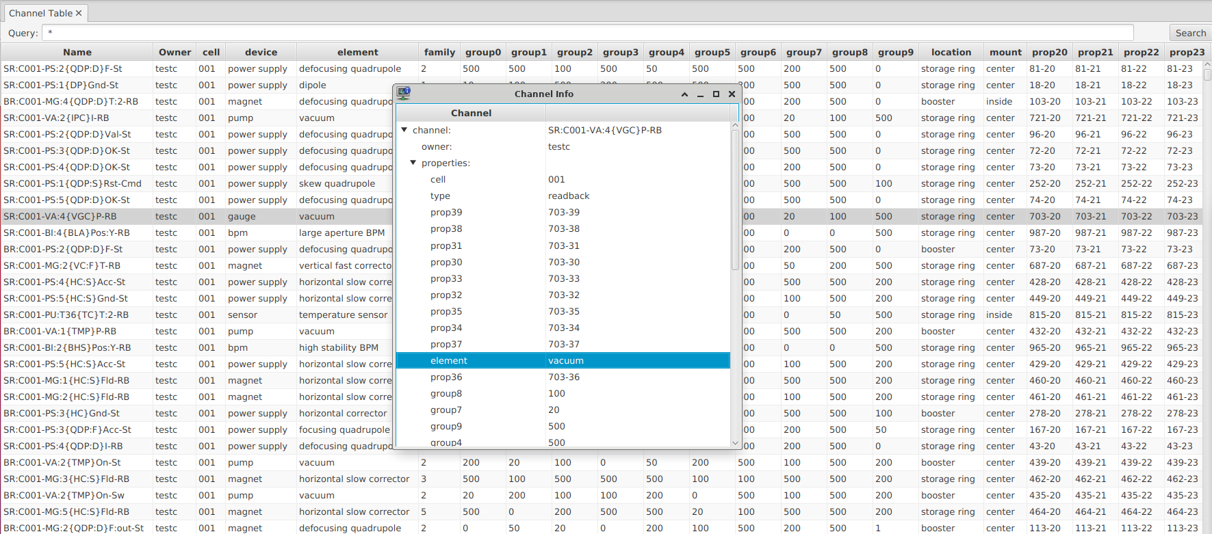
CS-Studio: Channel ‘Table’
More elaborate demo data from BNL

Slide 10
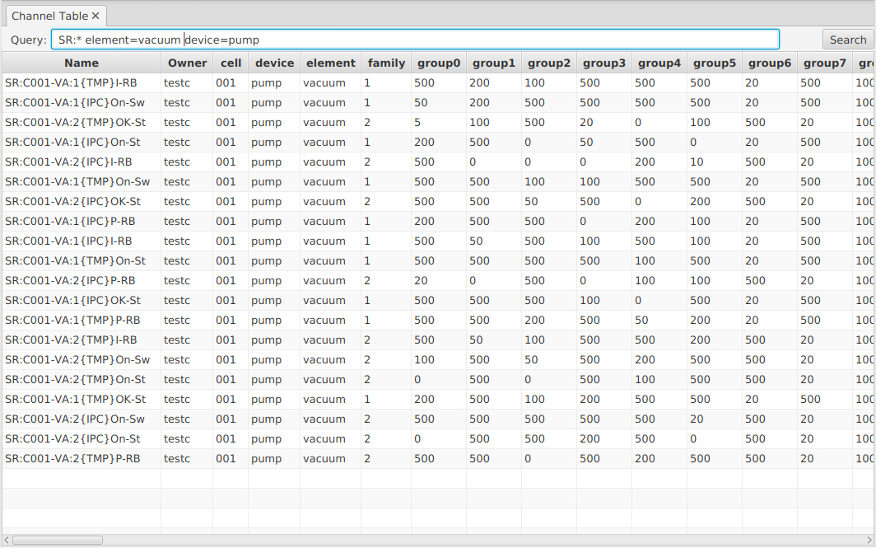
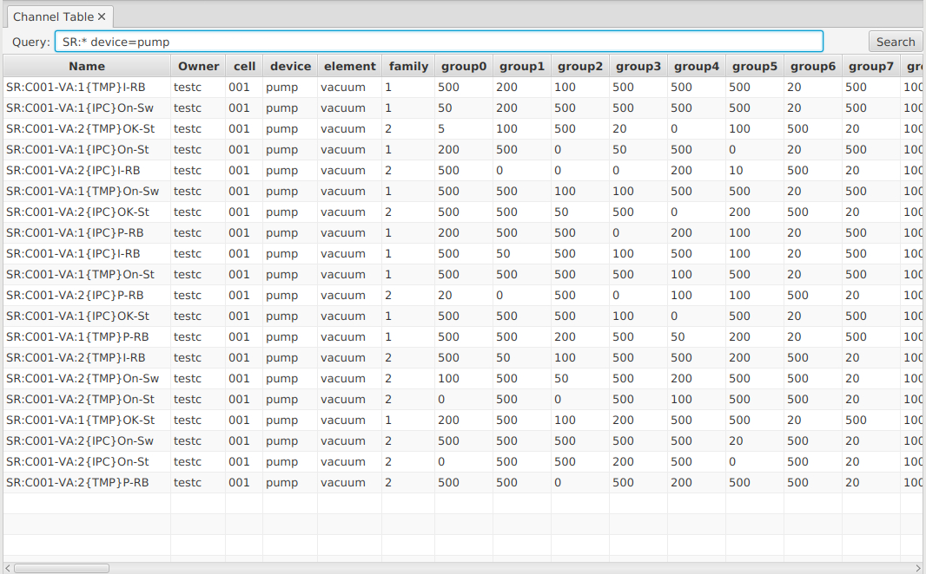
Search Options: “*Pattern* tag prop=*value*”

Slide 11
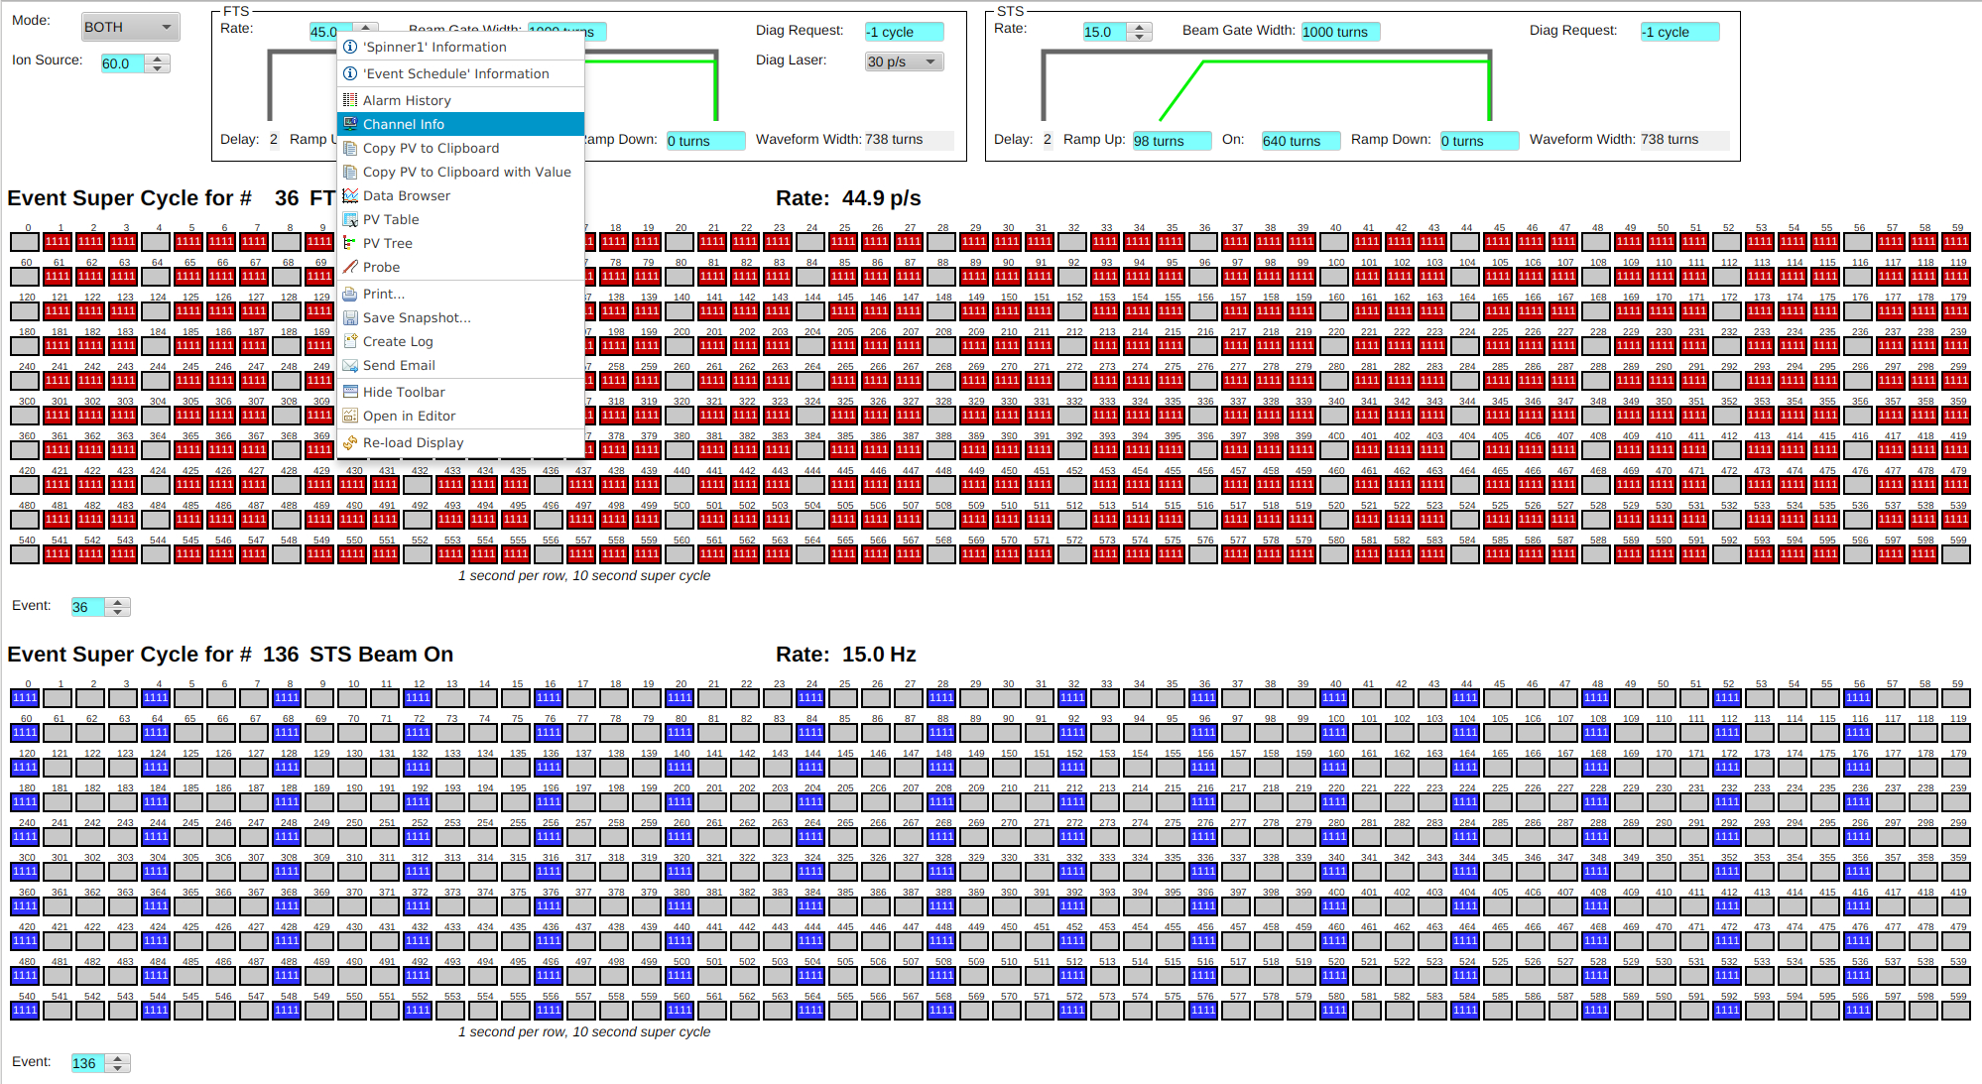
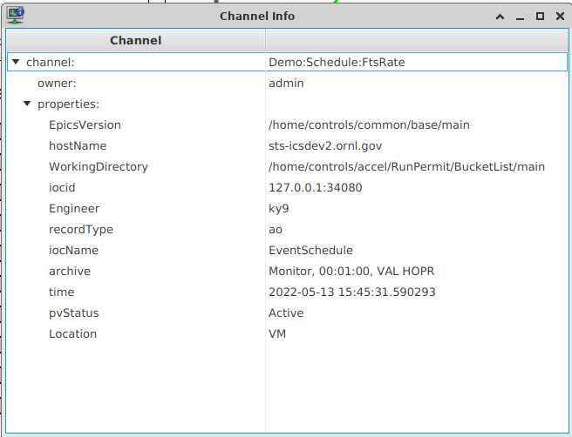
Integration

Slide 12
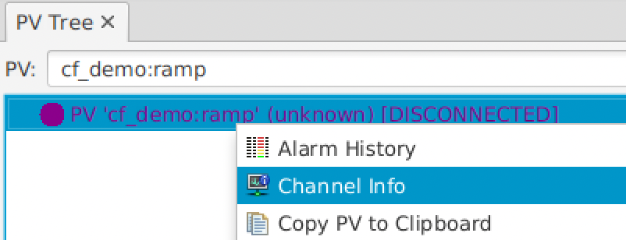
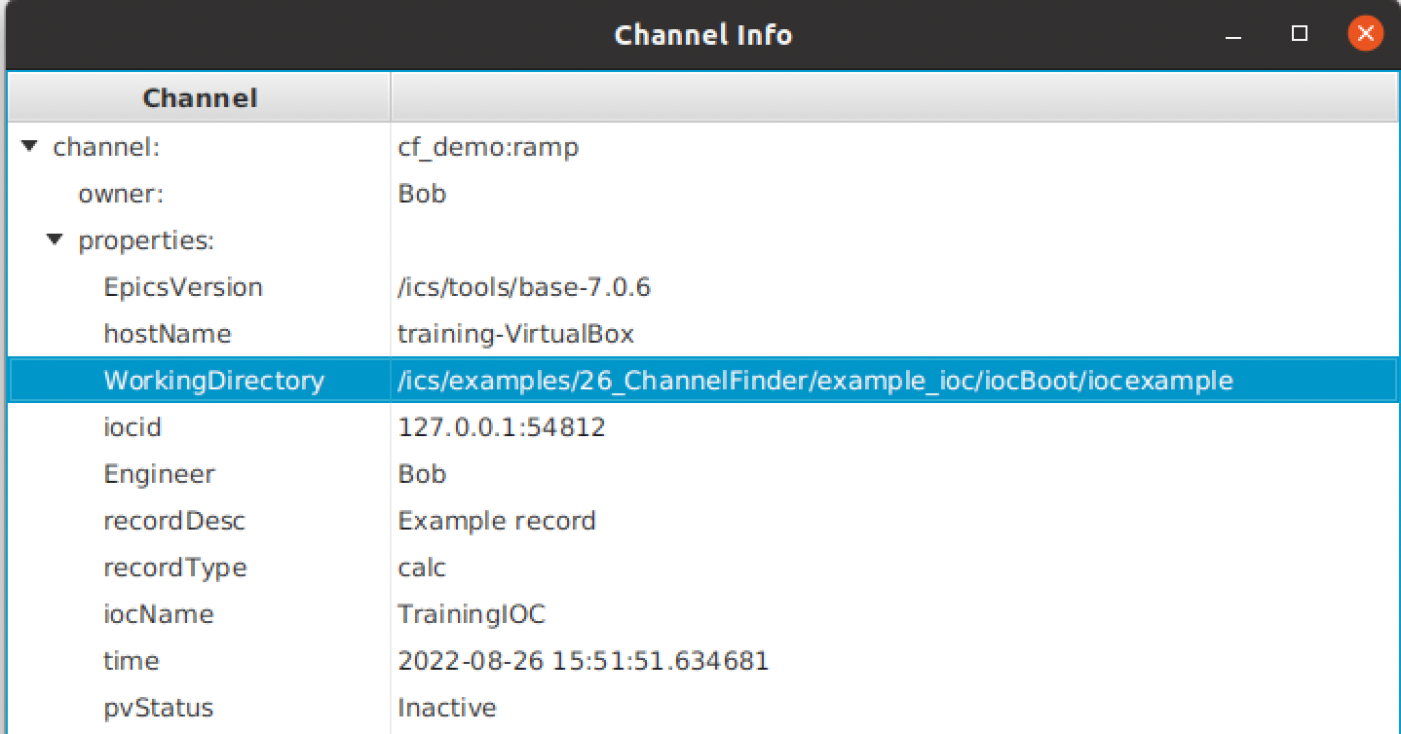
Especially useful for Disconnected Channels
What IOC is supposed to provide this channel?
When was IOC last seen?
Who to contact?
What host? Where on that host?

Slide 13
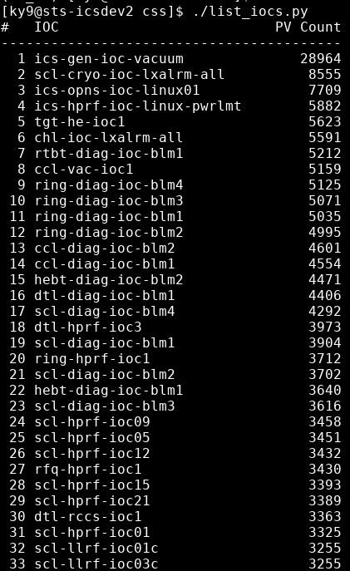
Create you own tools
List all IOCs and their PV counts
Create archive config

Slide 14
Elasticsearch: Count PVs
curl http://localhost:9200/channelfinder/_count?pretty
OK..

Slide 15
Elasticsearch: List IOCs
curl -XGET "http://localhost:9200/channelfinder/_search" -H 'Content-Type: application/json' -d'
{
"query":
{
"nested":
{
"path": "properties",
"query": { "match": { "properties.name": "iocName" } }
}
},
"size": 0,
"aggs":
{
"IOCs":
{
"nested": { "path": "properties" },
"aggs":
{
"filter_ioc":
{
"filter": { "bool": { "filter": [ { "term": { "properties.name": "iocName" } } ] } },
"aggs": { "ioc": { "terms": { "field": "properties.value", "size": 500 } } }
}
}
}
} }’ Well…

Slide 16
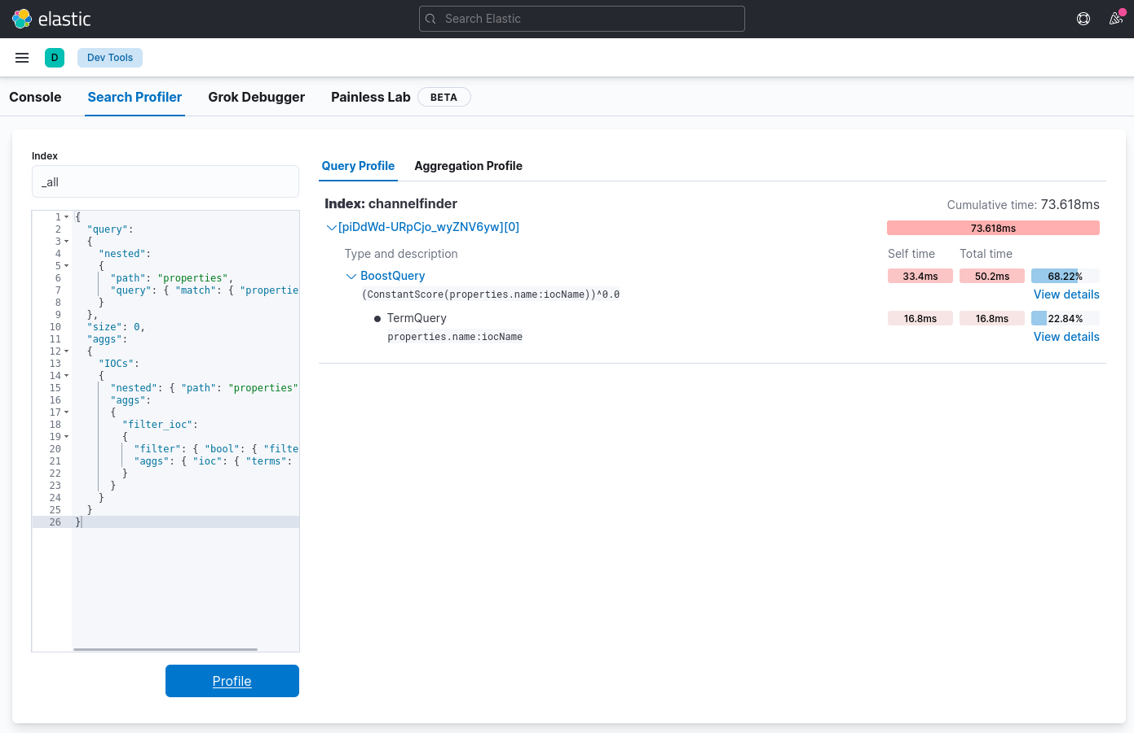
But it’s fast
Aggregate IOC names for 500k channels: 0.075 seconds

Slide 17
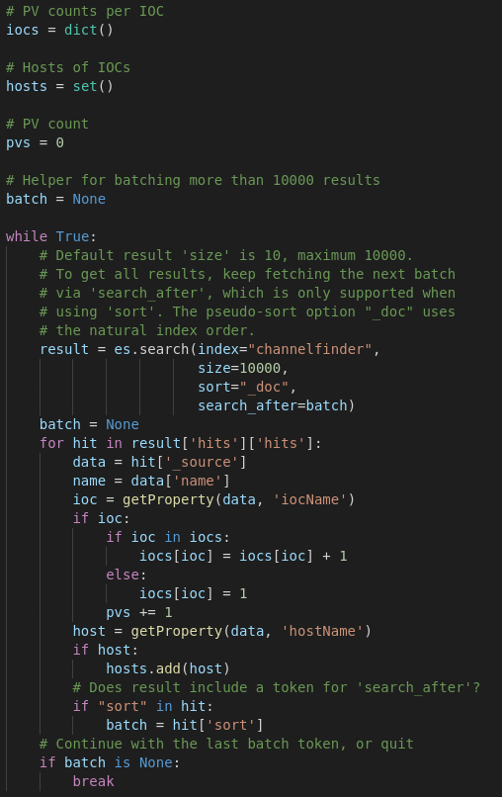
Python: Loop over all Channels, catalog IOCs, …
Loops over 500k PVs in about 10 seconds.
Nested structure

Slide 18
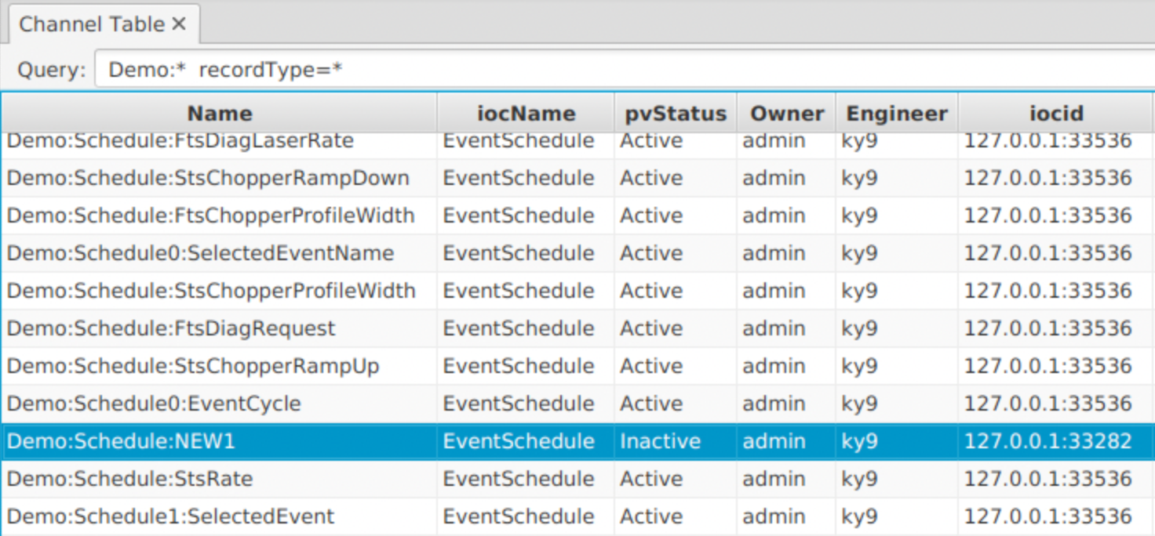
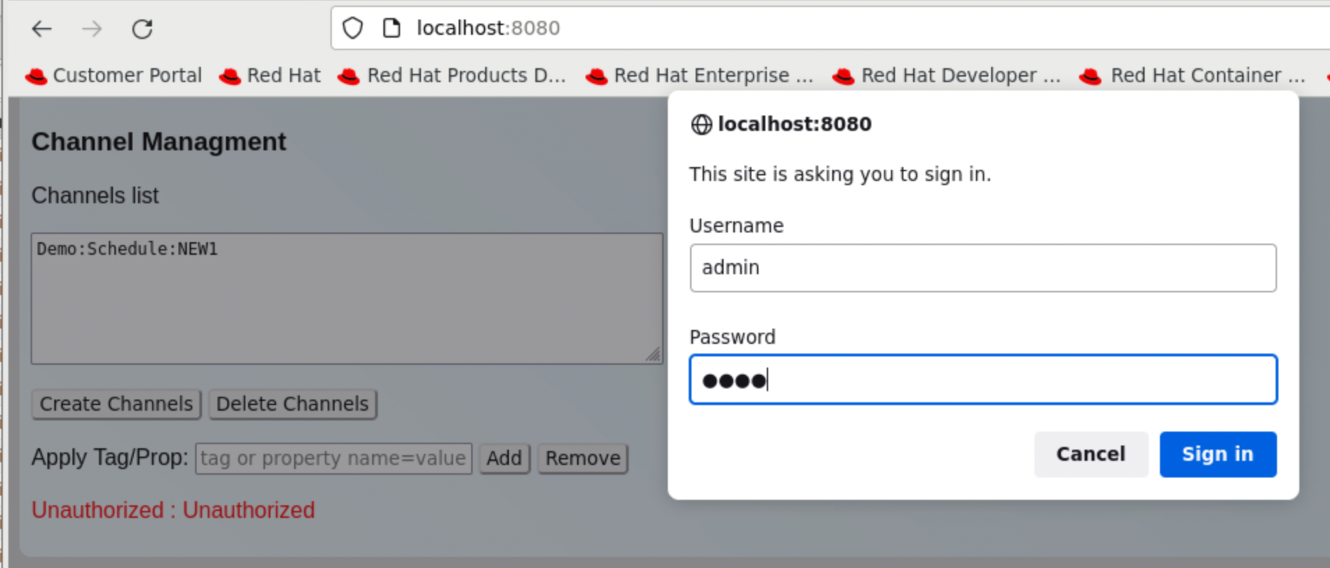
Questions
What happens when a record is removed from an IOC?
It remains in the channel finder but as “Inactive”
How to really delete channel?
Web interface, …

Slide 19
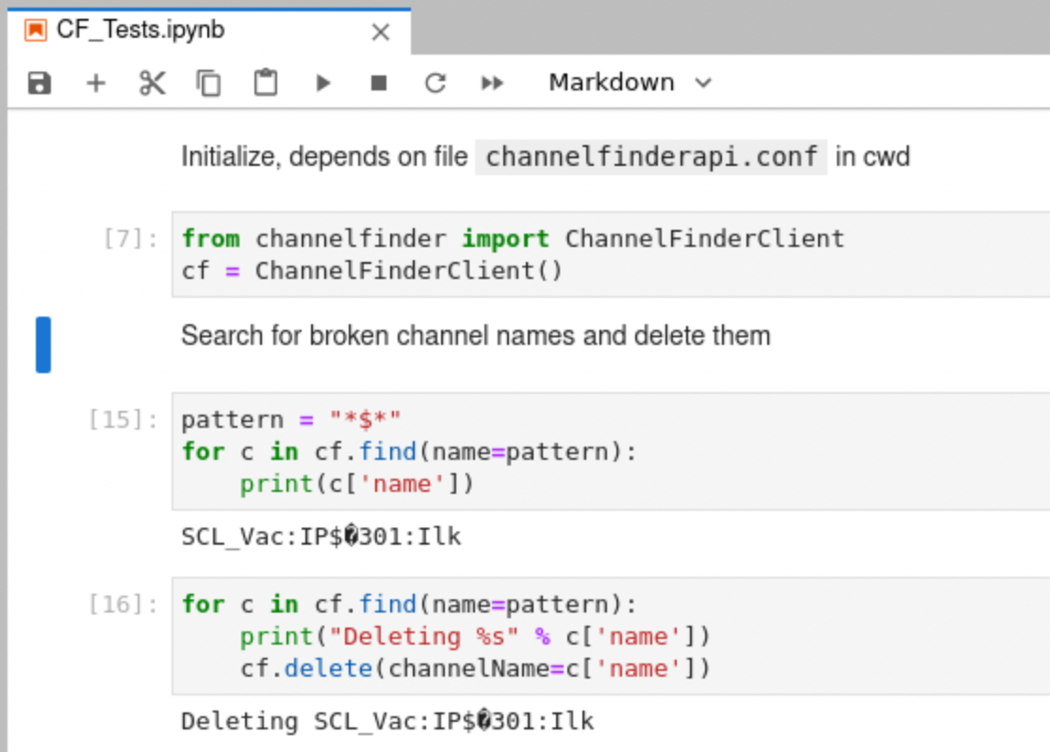
Python Notebook Example

Slide 20
Channel Finder
Database of channels
IOCs can publish their records
With host name, contact person, ..
”Recceiver” tracks Active/Inactive PV status
Easy name lookup in CS-Studio
You may add other information and use in python scripts

